Slide 1
Remaining topic

Slide 2
VB.NET Data Types
DATATYPE in a programming language describes that what type of data a variable can hold . When we declare a variable, we have to tell the compiler about what type of the data the variable can hold or which data type the variable belongs to.
Syntax : Dim VariableName as DataType
VariableName : the variable we declare for hold the values.
DataType : The type of data that the variable can hold
VB.NET sample :
Dim count As Integer
count : is the variable name
Integer : is the data type
The above example shows , declare a variable 'count' for holding integer values.
In the variable count we can hold the integer values in
the range of -2,147,483,648 to +2,147,483,647.

Slide 3
The follwing are the some of commonly using datatypes in vb.net.
Boolean
Boolean variables are stored 16 bit numbers and it can hold only True or false.
VB.NET Runtime type : System.Boolean
VB.NET declaration : dim check as Boolean
VB.NET Initialization : check = false
VB.NET default initialization value : false
Integer
Integer variables are stored sighned 32 bit integer values in the range of -2,147,483,648 to +2,147,483,647
VB.NET Runtime type : System.Int32
VB.NET declaration : dim count as Integer
VB.NET Initialization : count = 100
VB.NET default initialization value : 0

Slide 4
String
String variables are stored any number of alphabetic, numerical, and special characters . Its range from 0 to approximately 2 billion Unicode characters.
VB.NET Runtime type : System.String
VB.NET declaration : Dim str As String
VB.NET Initialization : str = "String Test"
VB.NET default initialization value : Nothing

Slide 5
In VisualBasic.Net we can convert a datatype in two ways. Implicit Conversion and Explicit conversion . Also we can convert a type value to a reference and reference value to a type value. These are called Boxing and unBoxing . Boxing referes value type to reference type and unboxing , reference type ot value type.

Slide 6
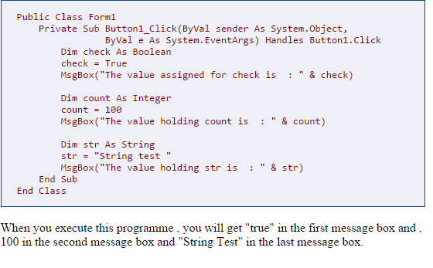

Slide 7
VB.NET Implicit and Explicit Conversions
Implicit Type Conversions
Implicit Conversion perform automatically in VB.NET, that is the compiler is taking care of the conversion.
The following example you can see how it happen.
1. Dim iDbl As Double
2. Dim iInt As Integer
3. iDbl = 9.123
4. MsgBox("The value of iDbl is " iDbl)
5. iInt = iDbl
6. MsgBox("The value of iInt is " iInt)
line no 1 : Declare a Double datatype variable iDble
line no 2 : Declare an Integer datatyoe variable iInt
line no 3 : Assign a decimal value to iDbl
line no 4 : Display the value of iDbl
line no 5 : Assign the value of iDbl to iInt
line no 6 : Display the value of iInt

Slide 8
The first messagebox display the value of iDbl is 9.123
The second messegebox display the value od iInt is 9
iInt display only 9 because the value is narrowed to 9 to fit in an Integer variable.
Here the Compiler made the conversion for us. These type fo conversions are called Implicit Conversion .
The Implicit Conversion perform only when the Option Strict switch is OFF

Slide 9
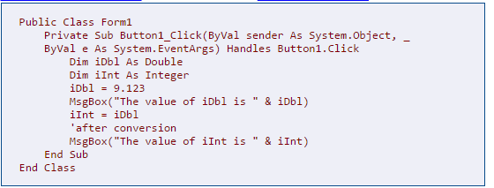

Slide 10
Explicit Type Conversions
In some cases we have to perform conversions , that is the compiler does not automatically convert a type to another . These type of conversion is called Explicit conversion . An explicit conversion uses a type conversion keyword. With these conversion keywords we hav to perform the Explicit Conversion.

Slide 11
How to VB.NET Access Specifiers
AccessSpecifiers describes as the scope of accessibility of an Object and its members. We can control the scope of the member object of a class using access specifiers. We are using access specifiers for providing security of our applications.
Visual Basic .Net provide five access specifiers , they are as follows :
Public, Private , Protected , Friend and ProtectedFriend .
Public :
Public is the most common access specifier. It can be access from anywhere, hat means there is no restriction on accessability. The scope of the accessibility is inside class also in outside the class.
Private :
The scope of the accessibility is limited only inside the classes in which they are decleared. The Private members can not be accessed outside the class and it is the least permissive access level.

Slide 12
Protected :
The scope of accessibility is limited within the class and the classses derived (Inherited )from this class.
Friend :
The Friend access specifier can access within the program that contain its declarations and also access within the same assembly level. You can use friend instead of Dim keyword.
ProtectedFriend :
ProtectedFriend is same access lebels of both Protected and Friend. It can access anywhere in the same assebly and in the same class also the classes inherited from the same class .

Slide 13
VB.NET Option Explicit [On | Off]
Option Explicit statement ensures whether the compiler requires all variables to be explicitly declared or not before it use in the program.
Option Explicit [On Off]
The Option Explicit has two modes. On and Off mode. If Option Explicit mode in ON , you have to declare all the variable before you use it in the program . If not , it will generate a compile-time error whenever a variable that has not been declared is encountered .If the Option Explicit mode is OFF , Vb.Net automatically create a variable whenever it sees a variable without proper declaration.
By default the Option Explicit is On
With the Option Explicit On , you can reduce the possible errors that result from misspelled variable names. Because in Option Explicit On mode you have to declare each variable in the program for storing data.

Slide 14
Take a look at the following programs, it will give you a clear picture of Option Explicit.
The following program is a normal vb.net program , so the default mode of Option Explicit On is using. The default is Option Explicit On , so we do not need to put it in the source code.

Slide 15
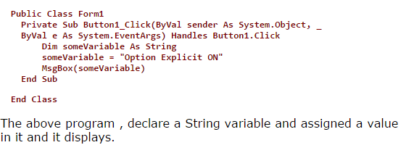

Slide 16
Take a look at the following program , it is an example of Option Explicit Of

Slide 17
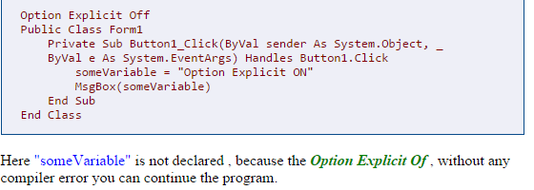

Slide 18
VB.NET Option Strict [On | Off]
Option Strict is prevents program from automatic variable conversions, that is implicit data type conversions .
Option Strict [On Off]
By default Option Strict is Off
From the following example you can understand the use of Option Strict.

Slide 19
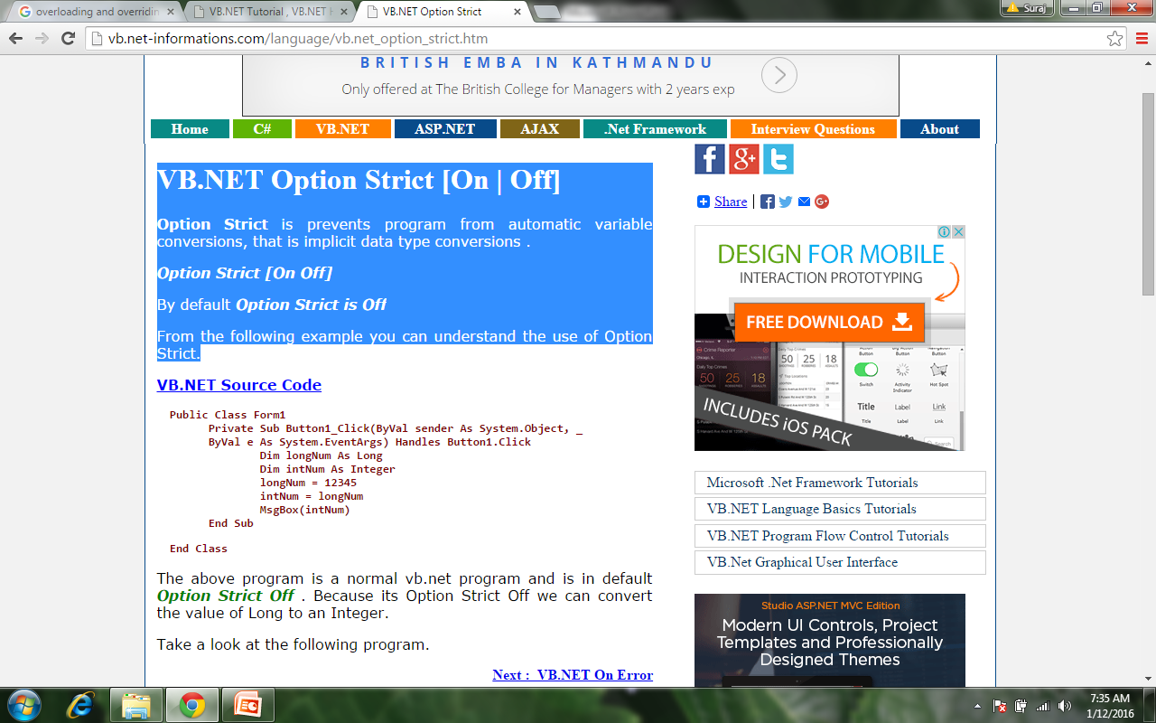

Slide 20
Take a look at the following program.

Slide 21
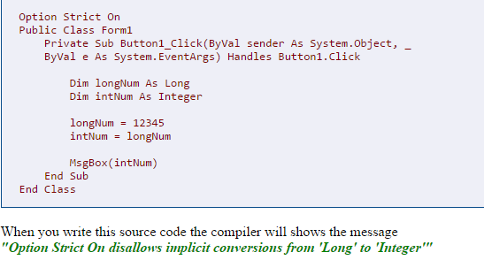

Slide 22
The compiler generate error because in the program we put "Option Strict On" and prevent the program from automatic conversion.

